Slide 1
Lesson 10
E115 – Programming and Data analysis

Slide 2
Lesson objectives
At the end of the lesson, you should be able to:
Obtain a linear regression model from given data
Apply the regression model to make predictions
Use Data Analysis ToolPak in Excel to generate regression and correlation coefficients, and interpret the output
Make use of Excel functions VLOOKUP, COUNTIF, SUMIF

Slide 3
Data Analysis
In L06, you have learnt how to plot a scatter diagram to observe the relationship between two variables, and also to compute and interpret the correlation (using the correlation coefficient, r) between two or multiple pairs of variables.
In this lesson, we will explore building a linear regression model for two variables having reasonably strong correlation, and learn how to use it to predict future values.
We will also explore the coefficient of determination (R²) between two variables and learn to interpret its value.

Slide 4
Regression Analysis
Regression Analysis is widely applied to solve real world problems.
The following are some real life applications of Regression Analysis:
A pharmaceutical company uses regression to assess the stability of the active ingredient in a drug to predict its shelf life.
A credit card company applied regression analysis to predict monthly gift card sales and improve yearly revenue projections.
An insurance company uses regression to determine the likelihood of a true problem existing when a home insurance claim was filed, in order to discourage customers from filing excessive or petty claims.

Slide 5
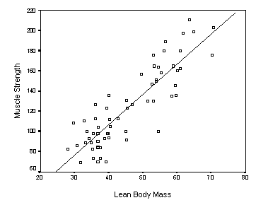
Simple linear regression
Simple linear regression is a statistical method that allows study of relationships between two continuous (quantitative) variables:
One variable, denoted as x, is regarded as the predictor variable.
The other variable, denoted as y, is regarded as the response variable.
The chart below illustrates the result of a study which suggests that people who have more lean body mass (x) tend to be stronger (y).
Source: http://www.jerrydallal.com/lhsp/slr.htm

Slide 6
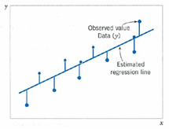
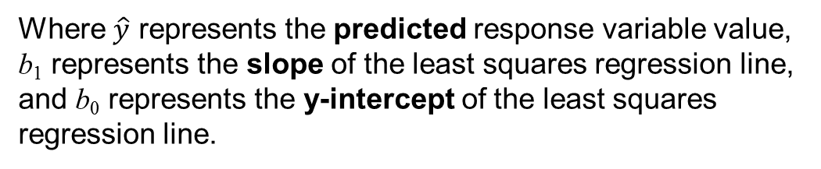
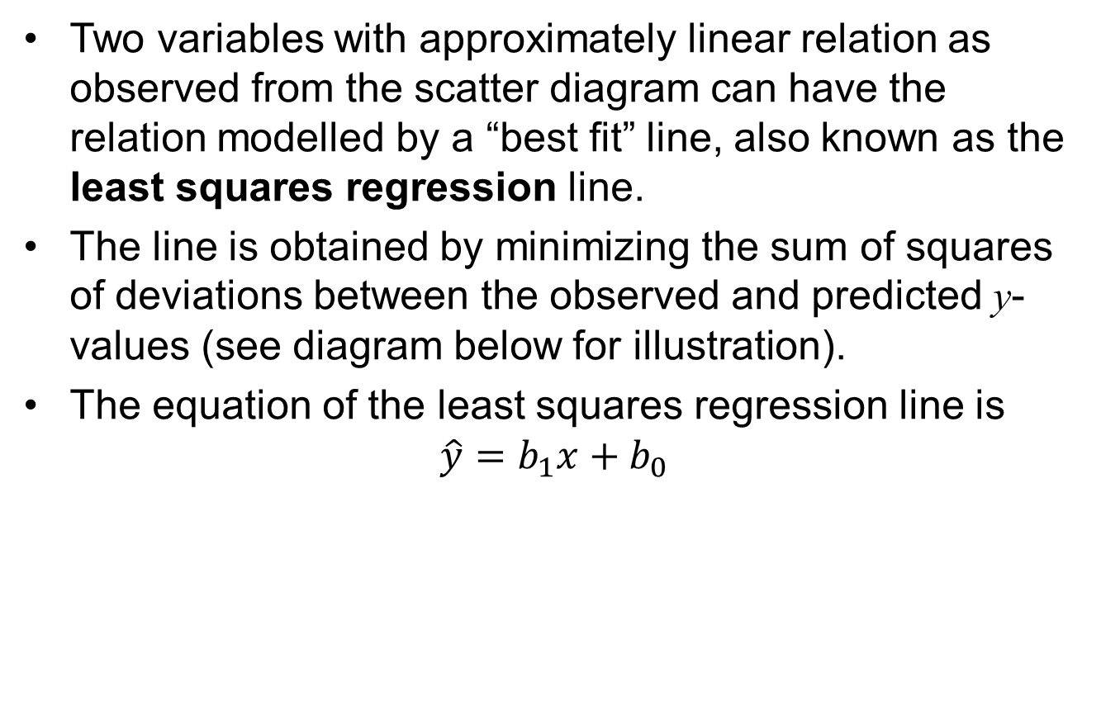
Simple linear regression
Two variables with approximately linear relation as observed from the scatter diagram can have the relation modelled by a “best fit” line, also known as the least squares regression line.
The line is obtained by minimizing the sum of squares of deviations between the observed and predicted y-values (see diagram below for illustration).
The equation of the least squares regression line is
$$\hat{y}=b_{1}x+b_{0}$$
Where $\hat{y}$ represents the predicted response variable value,
b₁ represents the slope of the least squares regression line, and b₀ represents the y-intercept of the least squares regression line.
Source: Montgomery, D.C., Runger, G.C., Applied Statistics and Probability for Engineers, John Wiley & Sons, Inc., 2011. Print.

Slide 7
Simple linear regression
We will go through two methods to obtain the equation of the least squares regression line.
Add Trendline in a scatter plot
Use Data Analysis ToolPak - Regression

Slide 8
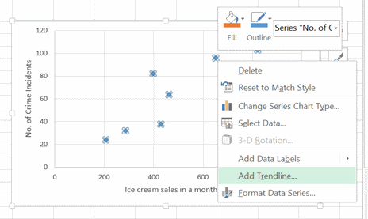
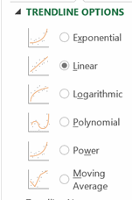
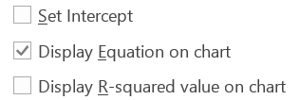
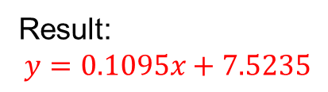
Do-it-with-me: Add Trendline
Go to the ‘Ice Cream & Crime’ sheet in L10_IS_Data.xlsx.
(All exercises in this session are found in this file.)
Plot a X-Y scatter chart (or refer to your work done in L06) with ice cream sales as x-axis
Right click on the data points – Add Trendline – Linear – Display Equation on chart
Result:
$$y=0.1095x+7.5235$$

Slide 9
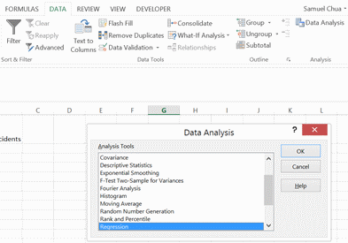
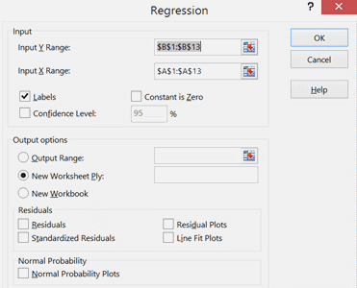
Do-it-with-me: Data Analysis ToolPak
Use the same data in ‘Ice Cream & Crime’ sheet.
Go to Data – Data Analysis – Regression – Click OK
Select the range of y and x values (including column headers) under “Input Y Range” and “Input X Range”, respectively. Check on “Labels”. Select ‘New Worksheet Ply’ to display the result in a new sheet. Click OK.

Slide 10
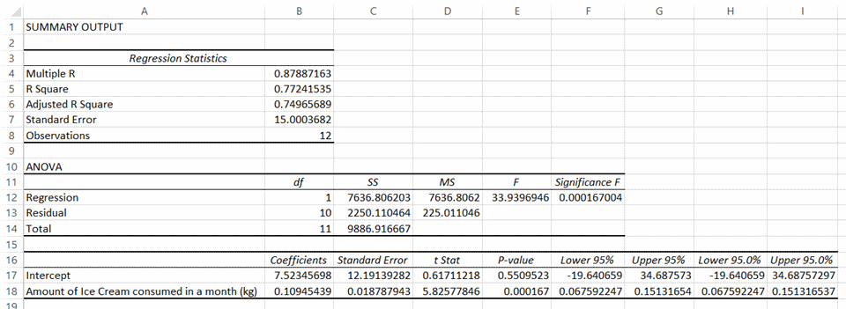
Do-it-with-me: Data Analysis ToolPak - Cont’d
Interpret the result
r, correlation coefficient
b₀, intercept coefficient
p-value of intercept coefficient
b₁, slope coefficient
p-value of slope coefficient
There is a very strong positive correlation between ice cream sales and the number of crime incidents in a month (r > 0.8)
The least squares regression model has a significant slope coefficient (p-value < 0.05) but insignificant intercept coefficient (p-value > 0.05).
The least squares regression line equation will be used for predictions only if both coefficients are significant.
Notes:
Lecturer to mention the R Square value before going to next slide

Slide 11
Coefficient of determination
The coefficient of determination, R², measures the proportion of total variation in the response variable (y) that is predictable from the predictor variable (x).
E.g. if a regression model has R² value of 0.9, it means that 90% of the variability in y is predictable from x.
In the last hands-on activity, since the R² value is 0.77241535, it means that approximately 77.2% of the variability in number of crime incidents a month can be predicted from the ice cream sales for that month.
The R² is the square of the correlation coefficient, r.
The coefficient of determination is always between 0 and 1, inclusive. i.e. 0 ≤ R² ≤ 1.
Notes:
Relate to result in previous slide

Slide 12
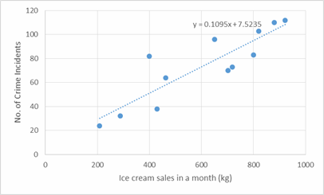
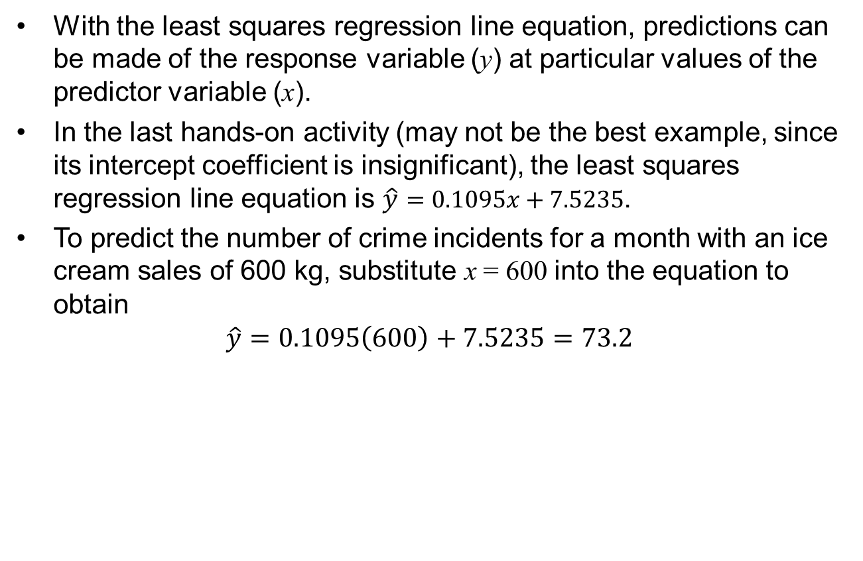
Predictions using regression model
With the least squares regression line equation, predictions can be made of the response variable (y) at particular values of the predictor variable (x).
In the last hands-on activity (may not be the best example, since its intercept coefficient is insignificant), the least squares regression line equation is $\hat{y}=0.1095x+7.5235$.
To predict the number of crime incidents for a month with an ice cream sales of 600 kg, substitute x = 600 into the equation to obtain
$$\hat{y}=0.1095\left(600\right)+7.5235=73.2$$
Note: The validity of the prediction is less certain at predictor variable values that are outside the range of the data set collected (e.g. at x = 100), as the relation between the variables may not be the same outside the studied range

Slide 13
Exercise 1
Refer to the ‘Infants Age & Weight’ sheet (an identical data set from a L06 exercise). The data is obtained from a study involving 17 infants to understand the correlation between gestational age at birth, measured in weeks, and birth weight, measured in grams.
Plot a X-Y scatter chart. Which variable is more appropriate to be the predictor variable (x)?
Add a Trendline displaying the regression line equation, and obtain the output from Data Analysis – Regression.
Answer the following:
What is the correlation strength between gestational age at birth and birth weight?
What is the least squares regression line equation?
Can the equation be used for making predictions? Explain.
For an infant with a gestational age of 32 weeks, what is his predicted birth weight?
What proportion of total variation in birth weight is predictable from the gestational age?

Slide 14
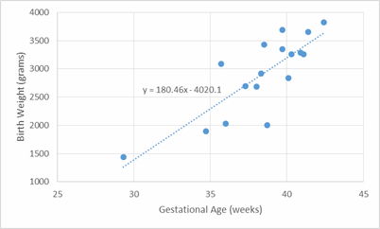
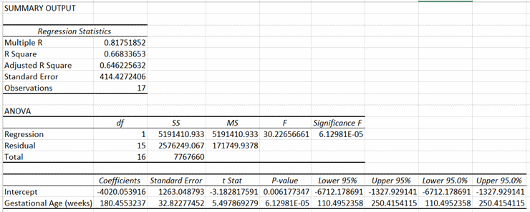
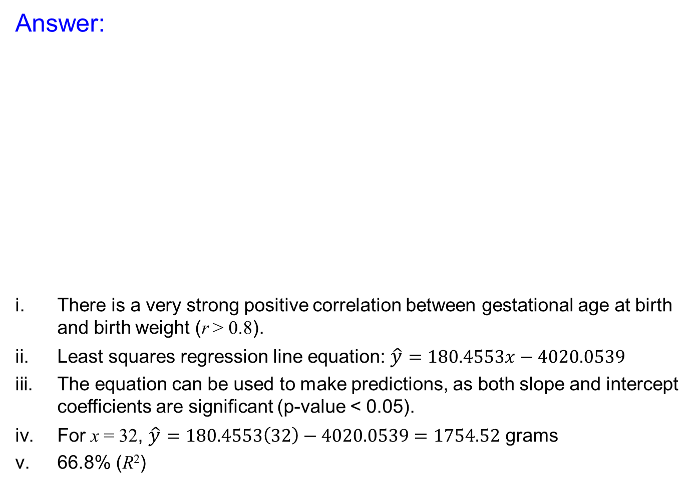
Exercise 1
Answer:
There is a very strong positive correlation between gestational age at birth and birth weight (r > 0.8).
Least squares regression line equation: $\hat{y}=180.4553x−4020.0539$
The equation can be used to make predictions, as both slope and intercept coefficients are significant (p-value < 0.05).
For x = 32, $\hat{y}=180.4553\left(32\right)−4020.0539=1754.52$ grams
66.8% (R²)

Slide 15
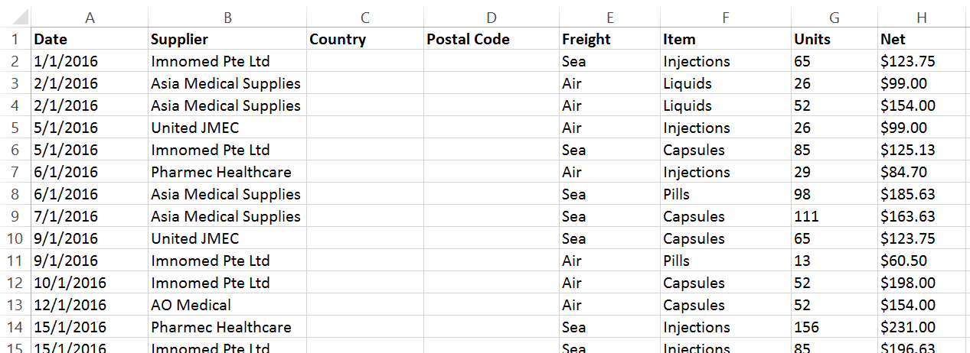
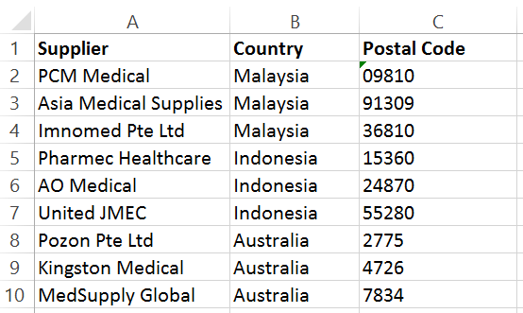
Excel function: VLOOKUP
VLOOKUP is an Excel function to lookup and retrieve data from a specific column in table.
"V" stands for “Vertical". VLOOKUP is designed to retrieve data in a table organized into vertical rows.
It is useful when you need to fill in multiple data with reference to another table. For example:
With reference
to these
Need to fill these

Slide 16
Excel function: VLOOKUP
When using the VLOOPUP function, the user will be prompted to enter 4 values:
=VLOOKUP(lookup_value, table_array, col_index_num, [range_lookup])
lookup_value: The value to look for
table_array: The table from which to retrieve a value (Note: The lookup values must be in the left-most column of the table)
col_index_num: The column in the table from which to retrieve a value
[range_lookup]: [optional] TRUE = approximate match (default). FALSE = exact match. (Note: In most cases, we will use exact match)
Notes:
For lecturers to elaborate in class, if necessary:
Approximate match are used in cases when you're looking for the best match, not an exact match, typically for numerical lookup values. Examples can be found in the follow websites:
https://exceljet.net/excel-functions/excel-vlookup-function
https://spreadsheeto.com/vlookup/

Slide 17
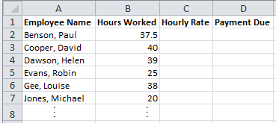
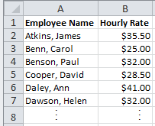
Excel function: VLOOKUP
[Example]
The hourly rate of employees of a company are to be filled in a sheet named ‘Payment’. The data is found in a sheet named ‘Hourly Pay’.
Payment
Hourly Pay
Column 2
=VLOOKUP(A2, ‘Hourly Pay’!$A$2:$B$100, 2, FALSE)
=VLOOKUP(lookup_value, table_array, col_index_num, [range_lookup])
Note: If the result is “#N/A”, it means the lookup value is not found in the lookup table
The table cells A2 to B100 are ‘locked’ with $ (or tap F4 key) for the same formula to be copied to subsequent cells below
Notes:
Source: http://www.excelfunctions.net/Vlookup-Example-Exact-Match.html

Slide 18
Exercise 2
In the ‘Purchases’ sheet of L10_IS_Data.xlsx, use the VLOOKUP function to enter the correct values in the ‘Country’ and ‘Postal Code’ columns by making reference to the table in the ‘Suppliers’ sheet.
Purchases
Suppliers

Slide 19
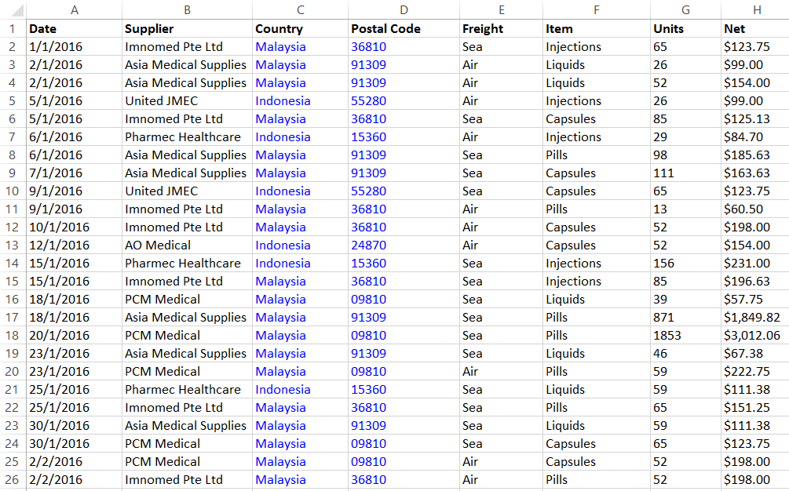
Exercise 2
Answer:

Slide 20
Excel function: COUNTIF
The COUNTIF function allows the user to count the number of cells within a selected range that meet a certain criterion.
It is useful for counting various labels that appear several times in a large data table.
When using the COUNTIF function, the user will be prompted to enter 2 values:
=COUNTIF(range, criteria)
range: The range of cells for counting to be done
criteria: The counting criterion (i.e. ‘what do you want to count?’)

Slide 21
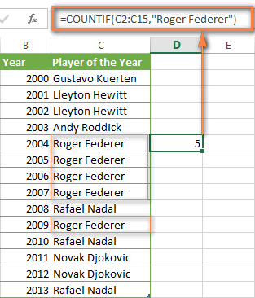
Excel function: COUNTIF
[Example]
=COUNTIF(range, criteria)
Notes:
Source: https://www.ablebits.com/office-addins-blog/2014/07/02/excel-countif-examples/

Slide 22
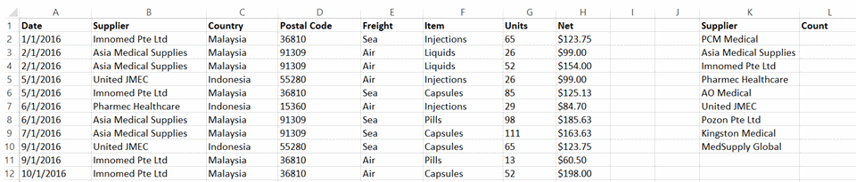
Exercise 3
The ‘Purchases’ sheet in L10_IS_Data.xlsx contains records of purchases made by a hospital to various medical suppliers in 2016 and 2017. Each row represents one purchase transaction.
In the ‘Purchases’ sheet, create a separate table in columns K and L (see below) to count the number of transactions made with each supplier over the past 2 years, using the COUNTIF function.
[Hint: To create the table quickly, copy column B to column K, go to ‘Data’ tab, ‘Remove duplicates’ in column K to remove repeated supplier names]

Slide 23
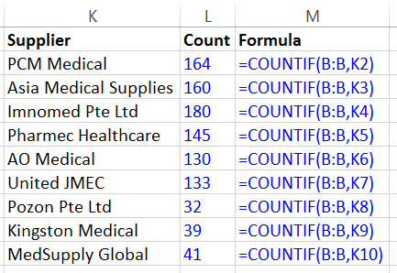
Exercise 3
Answer:

Slide 24
Excel function: SUMIF
The SUMIF function allows the user to adds all numbers in a range of cells based on a certain criterion.
It is useful for adding up numbers associated with a certain label that appear several times in a large data table.
When using the SUMIF function, the user will be prompted to enter 3 values:
=SUMIF(range, criteria, [sum_range])
range: The range of cells that you want to apply the criterion against
criteria: The criteria used to determine which cells to add
[sum_range]: Optional. It is the range of cells to sum together. If this parameter is omitted, it uses range as the sum_range.

Slide 25
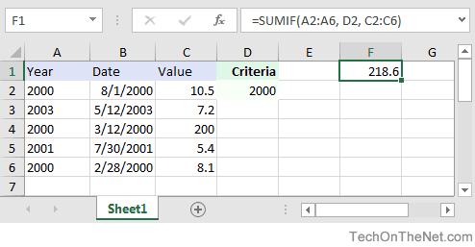
Excel function: SUMIF
[Example]
=SUMIF(range, criteria, [sum_range])
Notes:
Source: https://www.techonthenet.com/excel/formulas/sumif.php

Slide 26
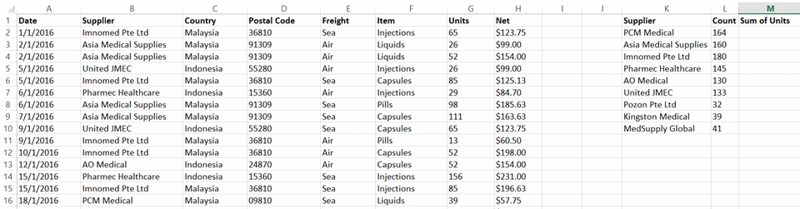
Exercise 4
In the separate table in ‘Purchases’ sheet created in Exercise 2, add a column in column M (see below) to sum up the total number of units purchased from each supplier over the past 2 years. Use the SUMIF function.

Slide 27
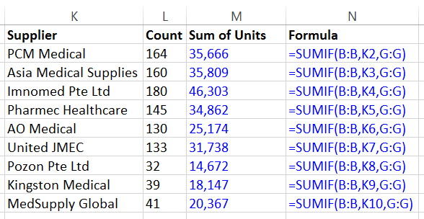
Exercise 4
Answer:

Slide 28
Going further… Pivot Tables
The slides after this will not be tested in the ESE.

Slide 29
PivotTable
PivotTables are a great way to summarize, analyze, explore, and present your data.
PivotTables are highly flexible and can be quickly adjusted depending on how you need to display your results.
You can also create PivotCharts based on PivotTables that will automatically update when your PivotTables do.
The counting and adding done in Exercise 2-3 earlier can be easily accomplished with PivotTable.

Slide 30
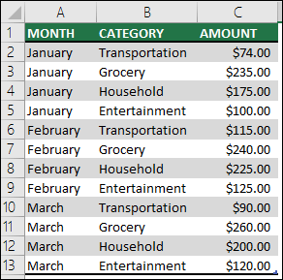
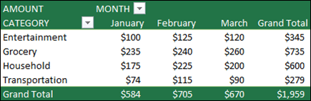
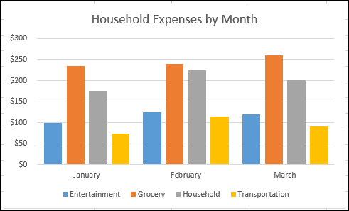
PivotTable
An example of what PivotTables and PivotCharts do:
Data table
Corresponding PivotTable
Corresponding PivotChart
Notes:
Source: https://support.office.com/en-us/article/create-a-pivottable-to-analyze-worksheet-data-a9a84538-bfe9-40a9-a8e9-f99134456576

Slide 31
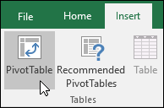
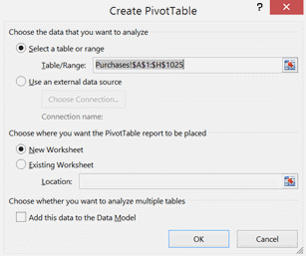
Do-it-with-me: PivotTable
Let’s use PivotTable to obtain the results of counting and adding in Exercise 2-3 done earlier. Go to ‘Purchases’ sheet in L10_IS_Data.xlsx.
Click a cell in the table.
Go to Insert > Tables > PivotTable.
Excel will display the Create PivotTable dialog with your data range in the table selected.
Select New Worksheet and click OK.

Slide 32
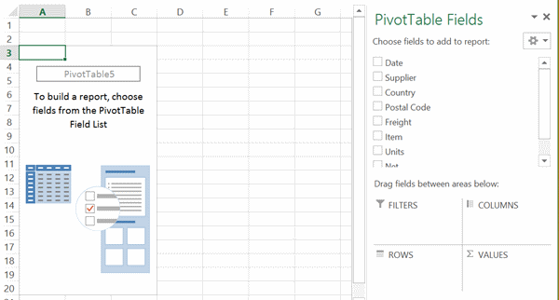
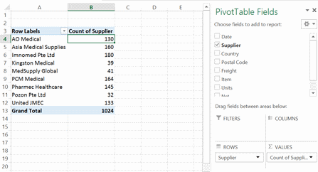
Do-it-with-me: PivotTable – Cont’d
Drag ‘Supplier’ to both ROWS and ∑ VALUES
Result:
Note: You can also drag any fields (e.g. Items) to ∑ VALUES as long as there are no blank cells for that field.

Slide 33
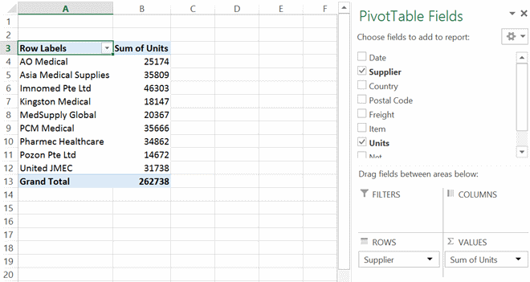
Do-it-with-me: PivotTable – Cont’d
Now remove ‘Supplier’ from ∑ VALUES (either by clicking on it – Remove Field, or dragging it out of the entire PivotTable Fields window) and replace it with Units.
Result:
Note: Notice that PivotTable automatically set it as ‘Sum’ instead of ‘Count’ as it reads numerical values instead of text.
If it still shows as ‘Count’ for you, click on it – Value Field Settings and change it to SUM.

Slide 34
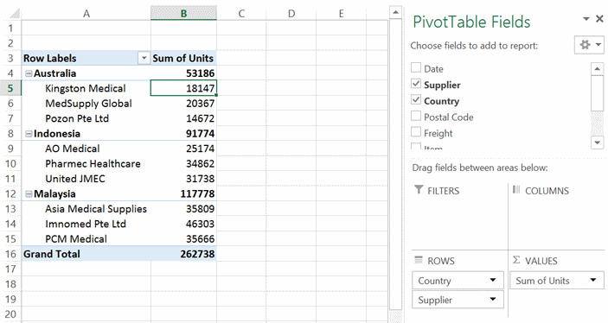
Do-it-with-me: PivotTable – Cont’d
Now drag ‘Country’ to ROWS, before ‘Supplier’.
Result:
Try shifting ‘Country’ to below ‘Supplier’ and see what happens. Which result is more meaningful?
Remove ‘Country’ from ROWS before the next activity.

Slide 35
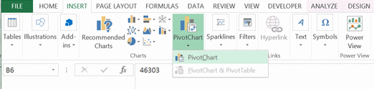
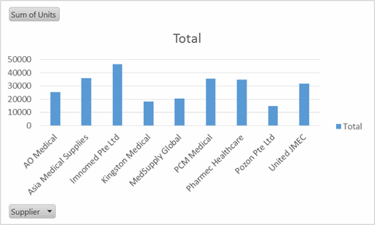
Do-it-with-me: PivotChart
Now let’s add a chart to the PivotTable you have created.
Click anywhere in the PivotTable and go to Insert > Charts > PivotChart.
Result:
Note: Clicking on this allows filtering to display selected suppliers only

Slide 36
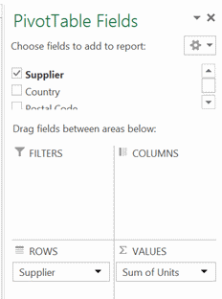
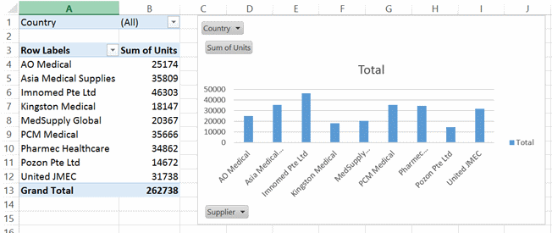
Do-it-with-me: PivotChart – Cont’d
Drag ‘Country’ to FILTERS
Result:
Note: Clicking on either one of these will filter to display suppliers from selected countries only

Slide 37
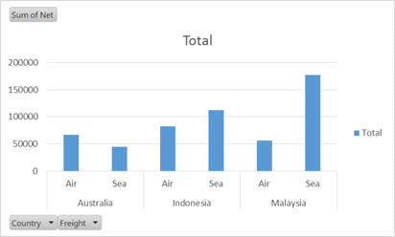
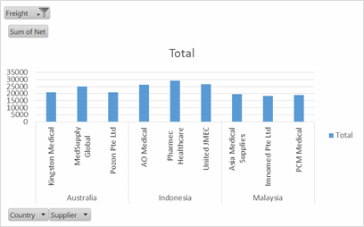
Exercise 5
Using the data in ‘Purchases’ sheet, plot a new PivotTable and PivotChart using Insert > Charts > PivotChart > PivotChart & PivotTable.
Perform the necessary actions to obtain the following charts.
Display freight by ‘Air’ only

Slide 38
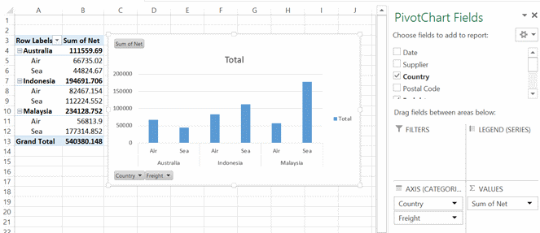
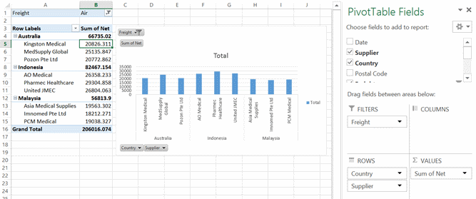
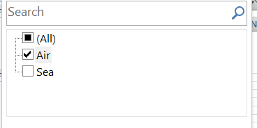
Exercise 5
Answer:

